Slide 1
Tableau Desktop & Server
Visually Analyze and Share Your Data

Slide 2

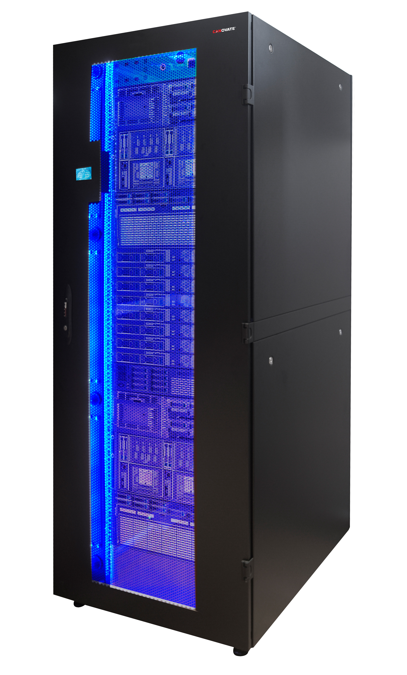
What is Tableau?
A business intelligence and data visualization tool allowing users to make sense of their data through interactive charts, graphs, and diagrams.
There are two main components: Desktop and Server
Desktop
Server

Slide 3
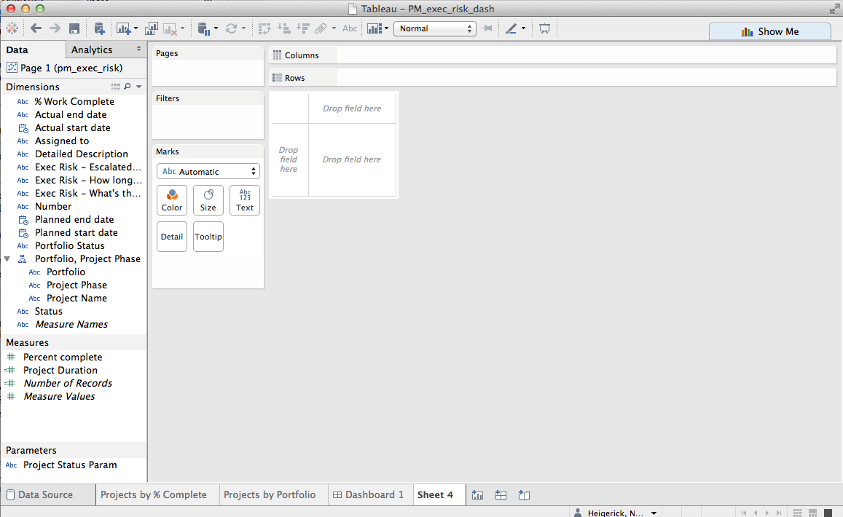
Tableau Desktop

Slide 4
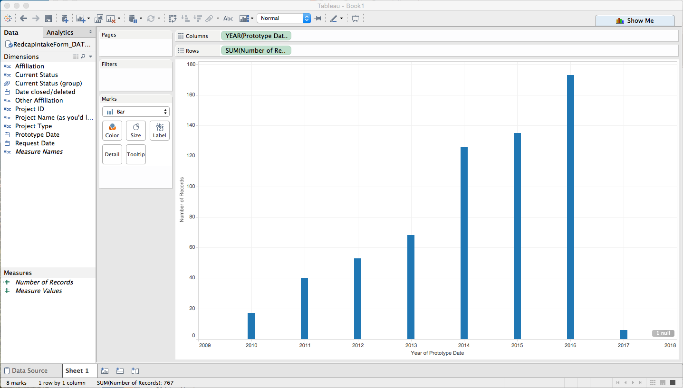
Tableau Desktop – Drag & Drop

Slide 5
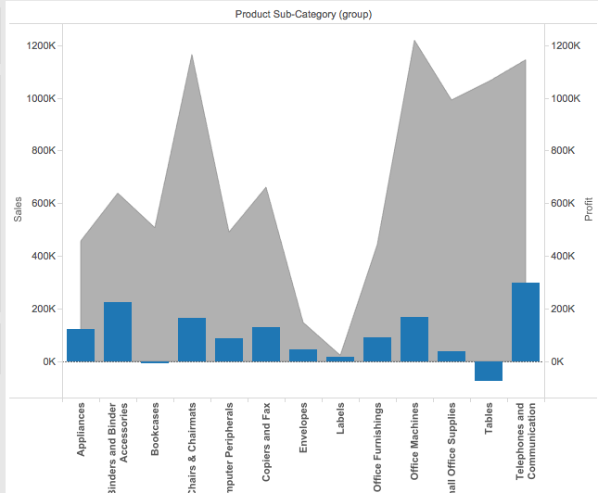
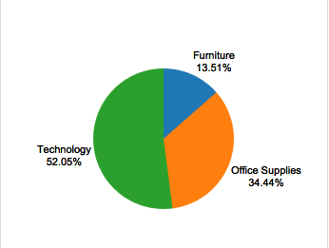
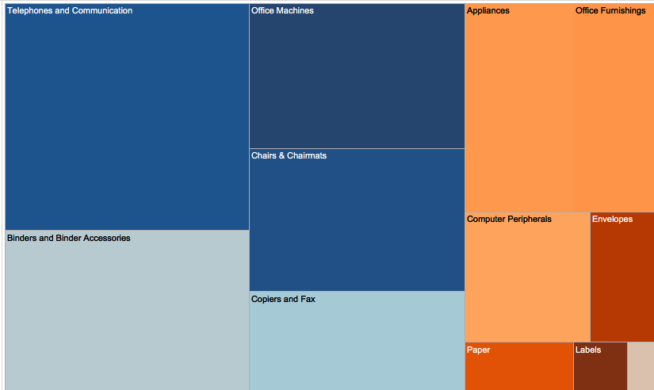
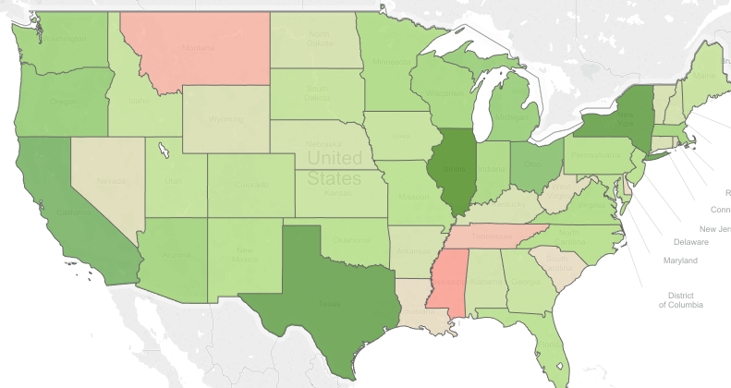
Tableau Visualization Examples

Slide 6
Interactive Dashboard Example

Slide 7
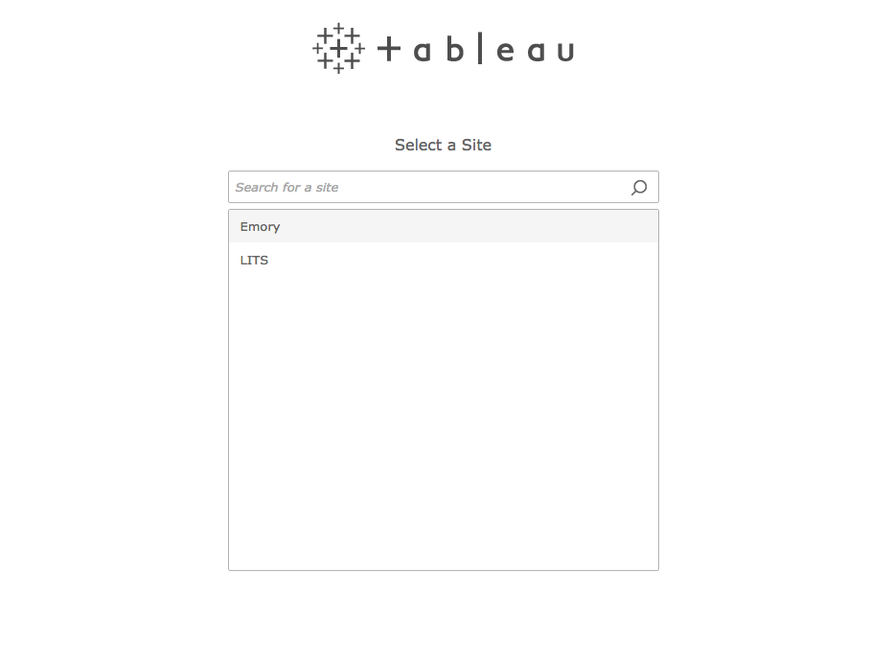
Tableau Server - Login

Slide 8
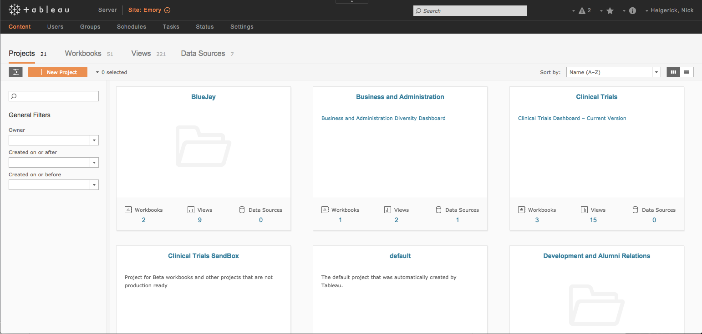
Tableau Server Home Screen

Slide 9
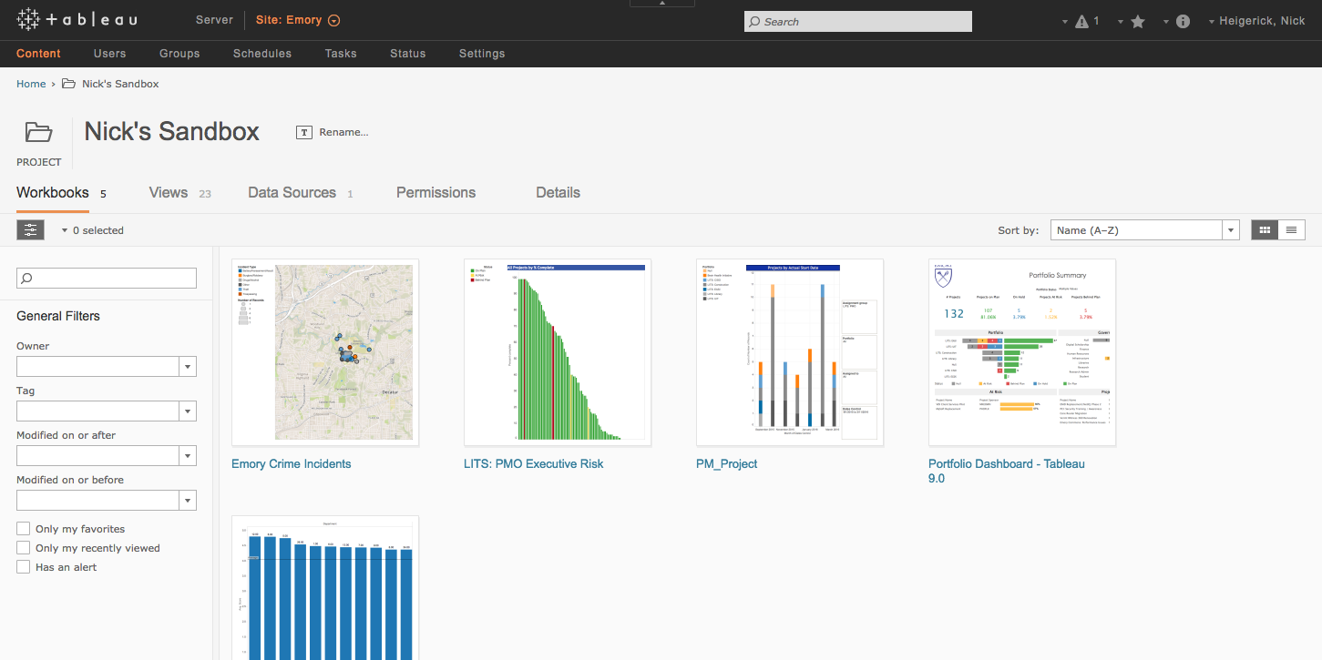
Tableau Server Project Folder

Slide 10
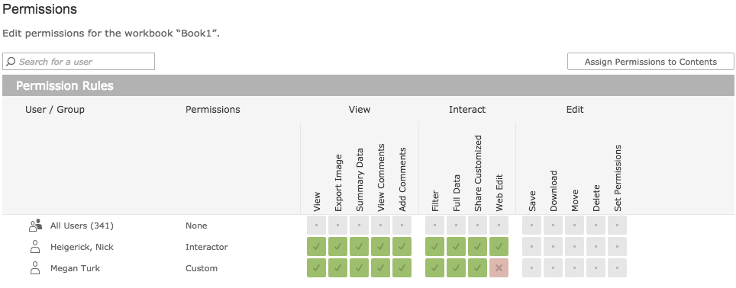
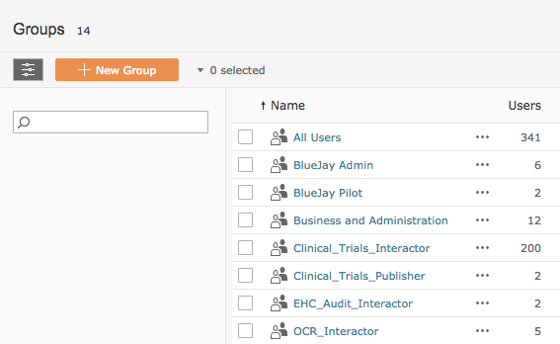
Controls / Access to Tableau Server
Who can access Tableau Server?
Any individual who has an Emory University ID or Emory Healthcare ID
Account has to be created by the System Admin.
Custom content access
Access to content on Tableau Server can be distributed by Group or Individual.
Permissions for each Group or Individual can be modified by for each Project or every Workbook. (See Picture)

Slide 11
Features of Tableau Desktop and Server
Desktop:
Connect to and aggregate data.
Flat files
Databases
Perform Joins and Blends
Create insightful analysis.
Drag and Drop functionality makes it easy to add and take away fields.
Tell compelling stories with your data.
Write custom calculations within your visualizations.
Set up filters.
Requires purchase of a license
Year 1: $1,500 (Software 1,200 & 300 Maintenance)
Year 2 & Beyond: $300 (Just Maintenance)
Server:
Share insights and information.
Share data, analyses, and visuals across all of Emory.
Get feedback.
Control access
Server allows you to define who has access and at what level.
Groups can be defined to quickly distribute access to large groups.
Licenses for uploading content to share with others.
Publisher License - $2,500 per year, billed monthly.

Slide 12
Support / Project Initiation
Tableau Licenses
Both Desktop and Server Licenses are acquired centrally by Emory’s Tableau Server Administrator.
Requirements:
Complete online Tableau Request Form.
Provide a smart key for the hosting fee.
Support
Library and Information Technology Services (LITS)
Email and phone support during working hours.
emorytableau-help@listserv.cc.emory.edu
Bi-Annual upgrades to Tableau Server to add new features and improvements.

Slide 13
Tableau
?
Questions

